Slide 2
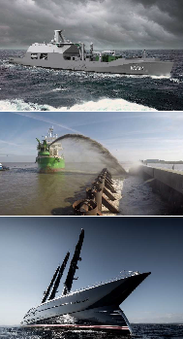
Alewijnse
All-round technological partner with over 130 years of experience in
Marine and Industry
Working in 4 segments
• Navy & Governmental,
• Dredging & Offshore,
• Yachting
• Industry
New build, Refit, Solutions, Panel-building, Repair & Maintenance projects
International Footprint, own branches in the Netherlands, Romania,
France and Vietnam
Competent & flexible
+/- 130 Engineers, +/- 600 Electrical Installers

Slide 3
Our History
Over a century of experience

Slide 4
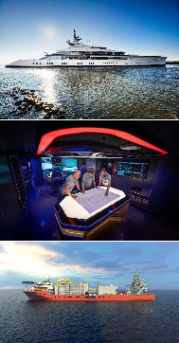
Our mission and vision
Mission
We Connect People and Technology
Vision
Our goal is to co-create value with and for our customers and
partners. We aim to develop and improve electrification and
automation solutions which are innovative, sustainable and of
the highest quality. We focus on making a valuable contribution
to successful projects in the Marine & Industry.

Slide 5
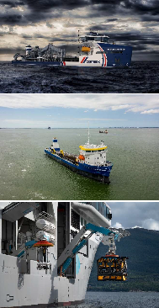
Our core values
Incorporated in the way we work

Slide 6
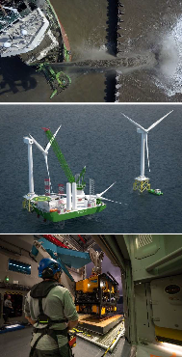
What we offer
Our solutions
• Vessel automation
• Process automation
• Navigation & Communication Systems
• Electric Installation
• Switchboards & Consoles
• Power Distribution
• Drive Systems
• Hybrid Systems
• Audio/Video & IT
• Safety & Security

Slide 7
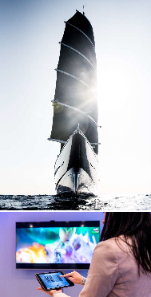
What we offer
Our expertises
All-round technological partner with over 130 years of experience in
Marine and Industry
Working in 4 segments
• Navy & Governmental,
• Dredging & Offshore,
• Yachting
• Industry
New build, Refit, Solutions, Panel-building, Repair & Maintenance projects
International Footprint, own branches in the Netherlands, Romania,
France and Vietnam
Competent & flexible
+/- 130 Engineers, +/- 600 Electrical Installers

Slide 8
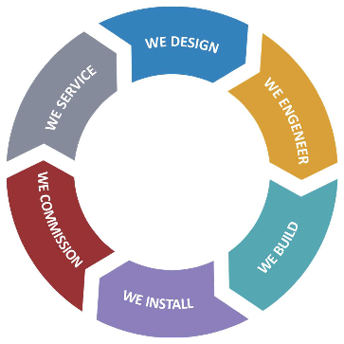
How we work
During the entire lifecicle

Slide 9
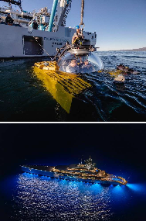
How we work
Through the value chain
We work
Safe
Sustainable
Quality focused

Slide 10
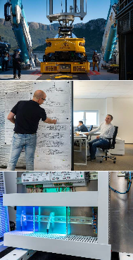
Why we are unique
Through the value chain
• Our specific industrial & maritime system knowledge
• Delivering high quality with attention to detail
• Our engineering capacity
• Our installing capacity
• Project management capabilities
• Global availability
• One stop shop
• Inhouse switchboard production (Vietnam; Romania; Netherlands)
• Refits & conversions knowledge
• 24/7 service & maintenance

Slide 11
Alewijnse group

Slide 12
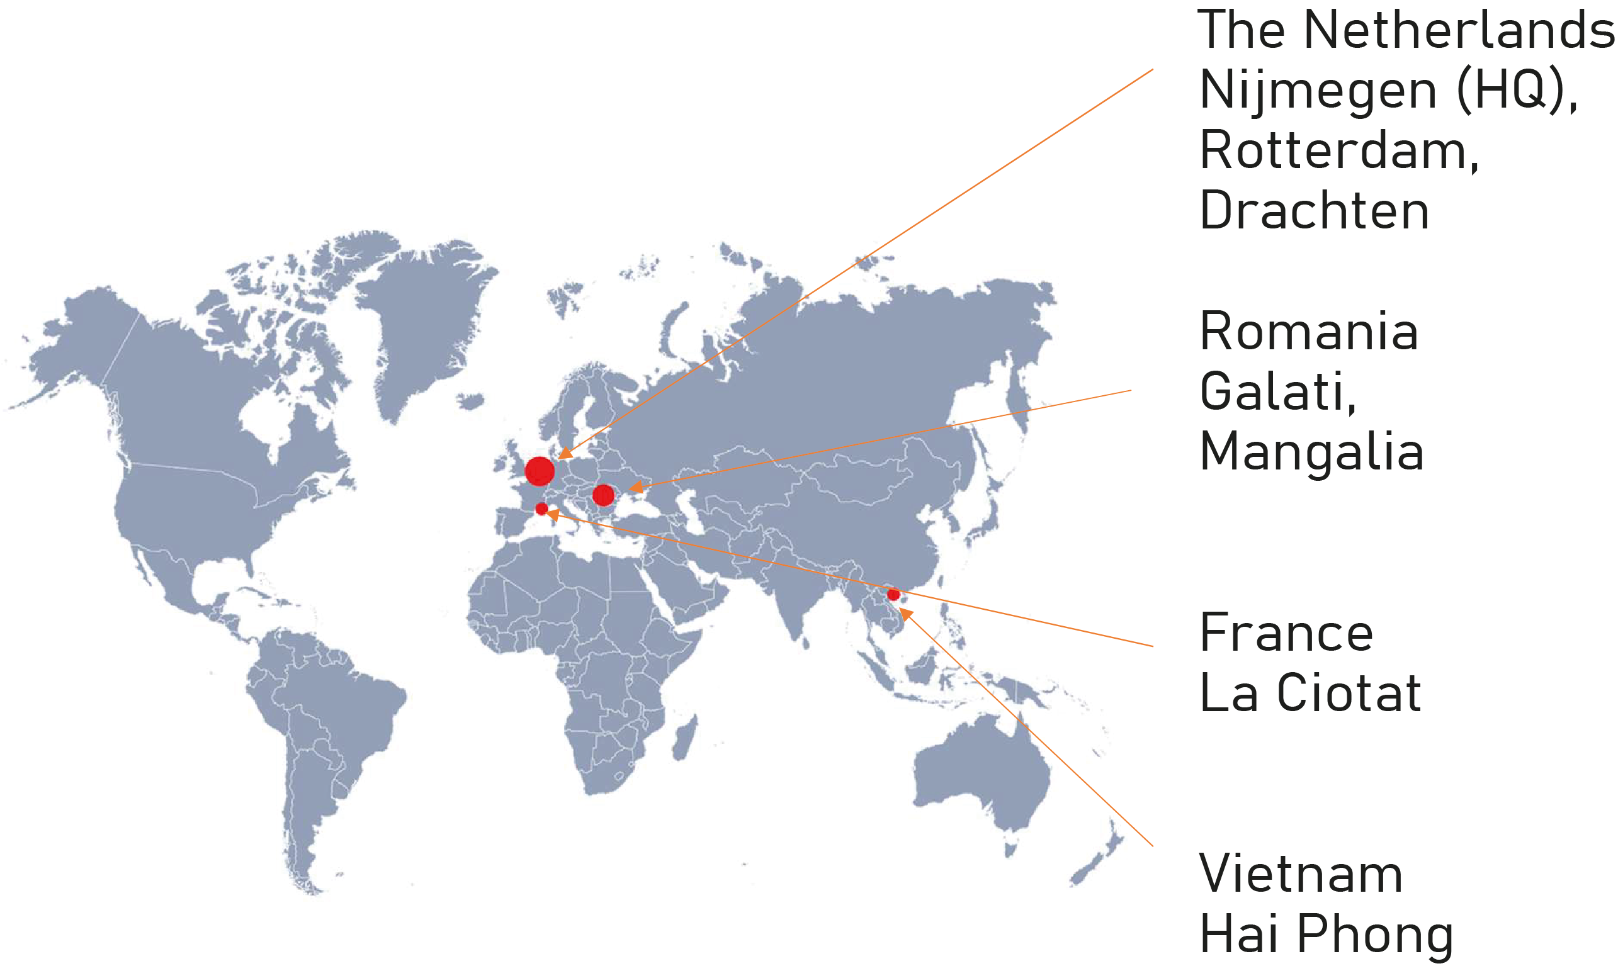
Our locations
Through the value chain

Slide 13
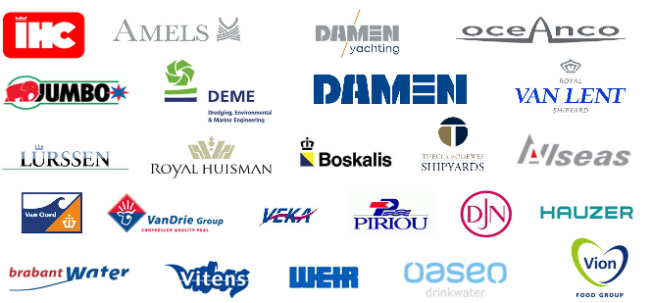
Our customers
Whom we connect

Slide 14
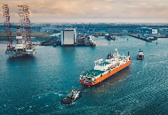
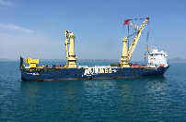
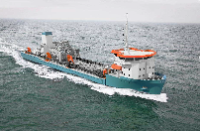
Dredging, Offhore & Transport
• Nuyina
• Icebreaker (160m)
• Newbuild: System
Integration; Complete
Electrical Installation
• Nuyina
• Icebreaker (160m)
• Newbuild: System
Integration; Complete
Electrical Installation
• Nuyina
• Icebreaker (160m)
• Newbuild: System
Integration; Complete
Electrical Installation

Slide 15
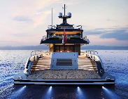
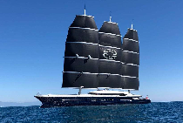
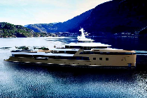
Yachting
• Amels 60
• Super Yacht (120m)
• Newbuild: Complete
electrical, Nav-Com
and AV-IT systems
installation
Black Pearl
• Sailing Yacht (106m)
• Newbuild: System
Integration; Complete
Electrical Installation
• SeaXplorer La Datcha
• Expedition Yacht (77m)
• Newbuild: AVIT system; CCTV system

Slide 16
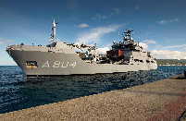
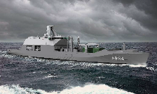
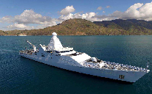
Naval & Governemental
• Zr. Ms. Den Helder
• Combat Support Ship
(179,5 meter)
• Newbuild: installation
activities, including of
the military equipment
Reformador
• Long Rage Ocean Patrol
Vessel (107,5m)
• Newbuild: System Integration; Installing; Supervising; Commissioning on site
• Zr. Ms. Pelikaan
• Naval Auxilary Vessel (65m)
• Refit: Mid-life upgrade
and maintenance

Slide 17
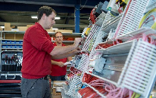
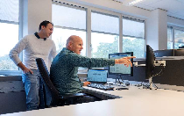
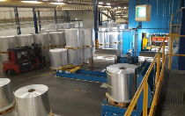
Industry
• Food
• T. Boer & Zn
• New main distributor
for extra cold storage
• Water
• Vitens
• Nine wells on production sites
• Process and manufacturing
• Ardagh Metal
• Cabling for new
production line

Slide 18
Why choose Alewijnse?
Customer quotes
‘’The quality is outstanding’’
“Alewijnse works with you as a co-maker and partner.”
“The company has got in depth knowledge on multiple systems in many branches.”
“We are confident in their ability to meet challenges on complex, specialist vessels.”
“The company’s design and installation engineers form a valuable part of our yard team.”
“Our projects are completed thanks to excellent all-round cooperation
and the total commitment.”
“Alewijnse shows that they are flexible and can handle a service job
like this using local staff and their remote access capability.“

Slide 19
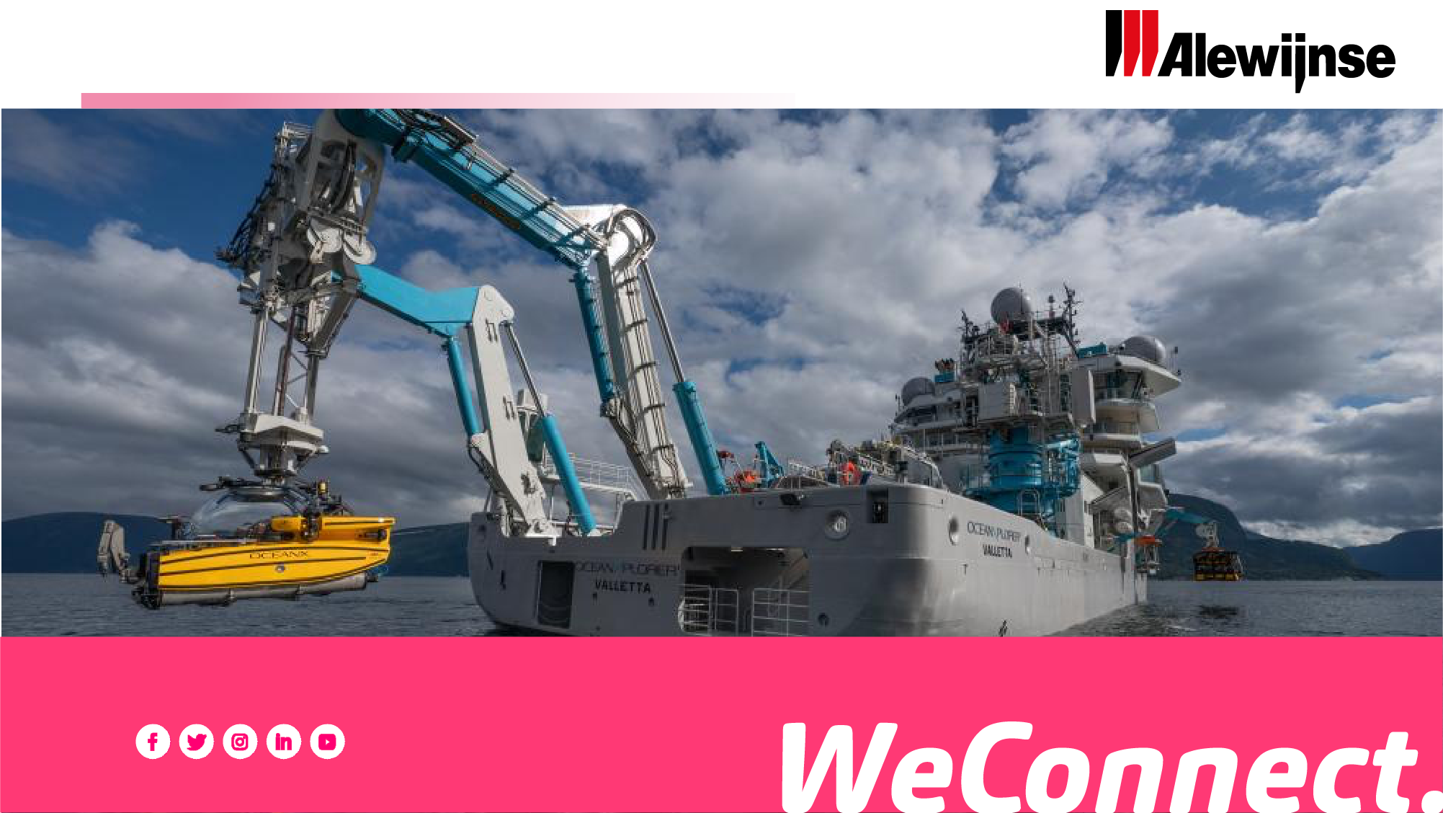
Ready for innovation?

