Slide 1



Automate The Boring
Engineer The Awesome
CONSULTANCY &
AUTOMATED ENGINEERING

Slide 2
CONSULTANCY
Early involvement
Data & event analysed modeling
Return of invest prognoses
Total cost of ownership analyses
Maintenance analyses
Overall equipment effectiveness
Brand independent

Slide 3
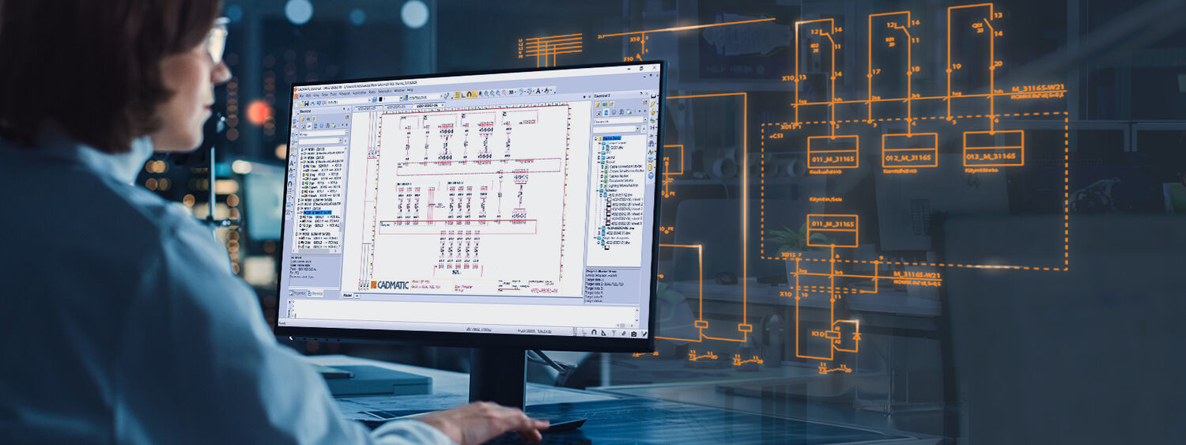
Early involvement

Slide 4
CONSULTANCY
Early involvement
Data & event analysed modeling
Return of invest prognoses
Total cost of ownership analyses
Maintenance analyses
Overall equipment effectiveness
Brand independent

Slide 5
Data & event analysed modeling

Slide 6
CONSULTANCY
Early involvement
Data & event analysed modeling
Return of invest prognoses
Total cost of ownership analyses
Maintenance analyses
Overall equipment effectiveness
Brand independent

Slide 7
Return of invest prognoses

Slide 8
CONSULTANCY
Early involvement
Data & event analysed modeling
Return of invest prognoses
Total cost of ownership analyses
Maintenance analyses
Overall equipment effectiveness
Brand independent

Slide 9
Total cost of ownership i.c.w. ROI

Slide 10
CONSULTANCY
Early involvement
Data & event analysed modeling
Return of invest prognoses
Total cost of ownership analyses
Maintenance analyses
Overall equipment effectiveness
Brand independent

Slide 11
Maintenance analyses

Slide 12
CONSULTANCY
Early involvement
Data & event analysed modeling
Return of invest prognoses
Total cost of ownership analyses
Maintenance analyses
Overall equipment effectiveness
Brand independent

Slide 13
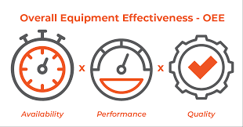
Overall equipment effectiveness (OEE)

Slide 14



Automated Engineering
Strong collaboration with TU Delft
Multiple internship and thesis projects realised
Matlab & Simulink simulation software
Advanced data visualisation and time domain analysis
ETAP simulation software
Advanced power system analysis studies

Slide 15
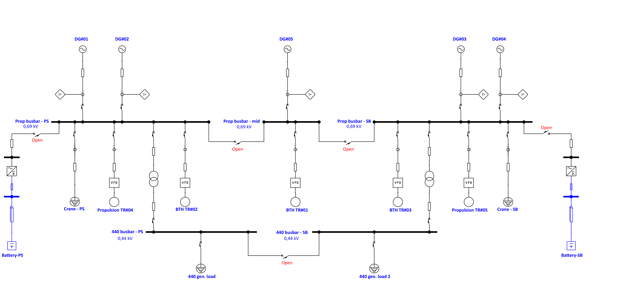
Automated Engineering
AC busbar simulation

Slide 16
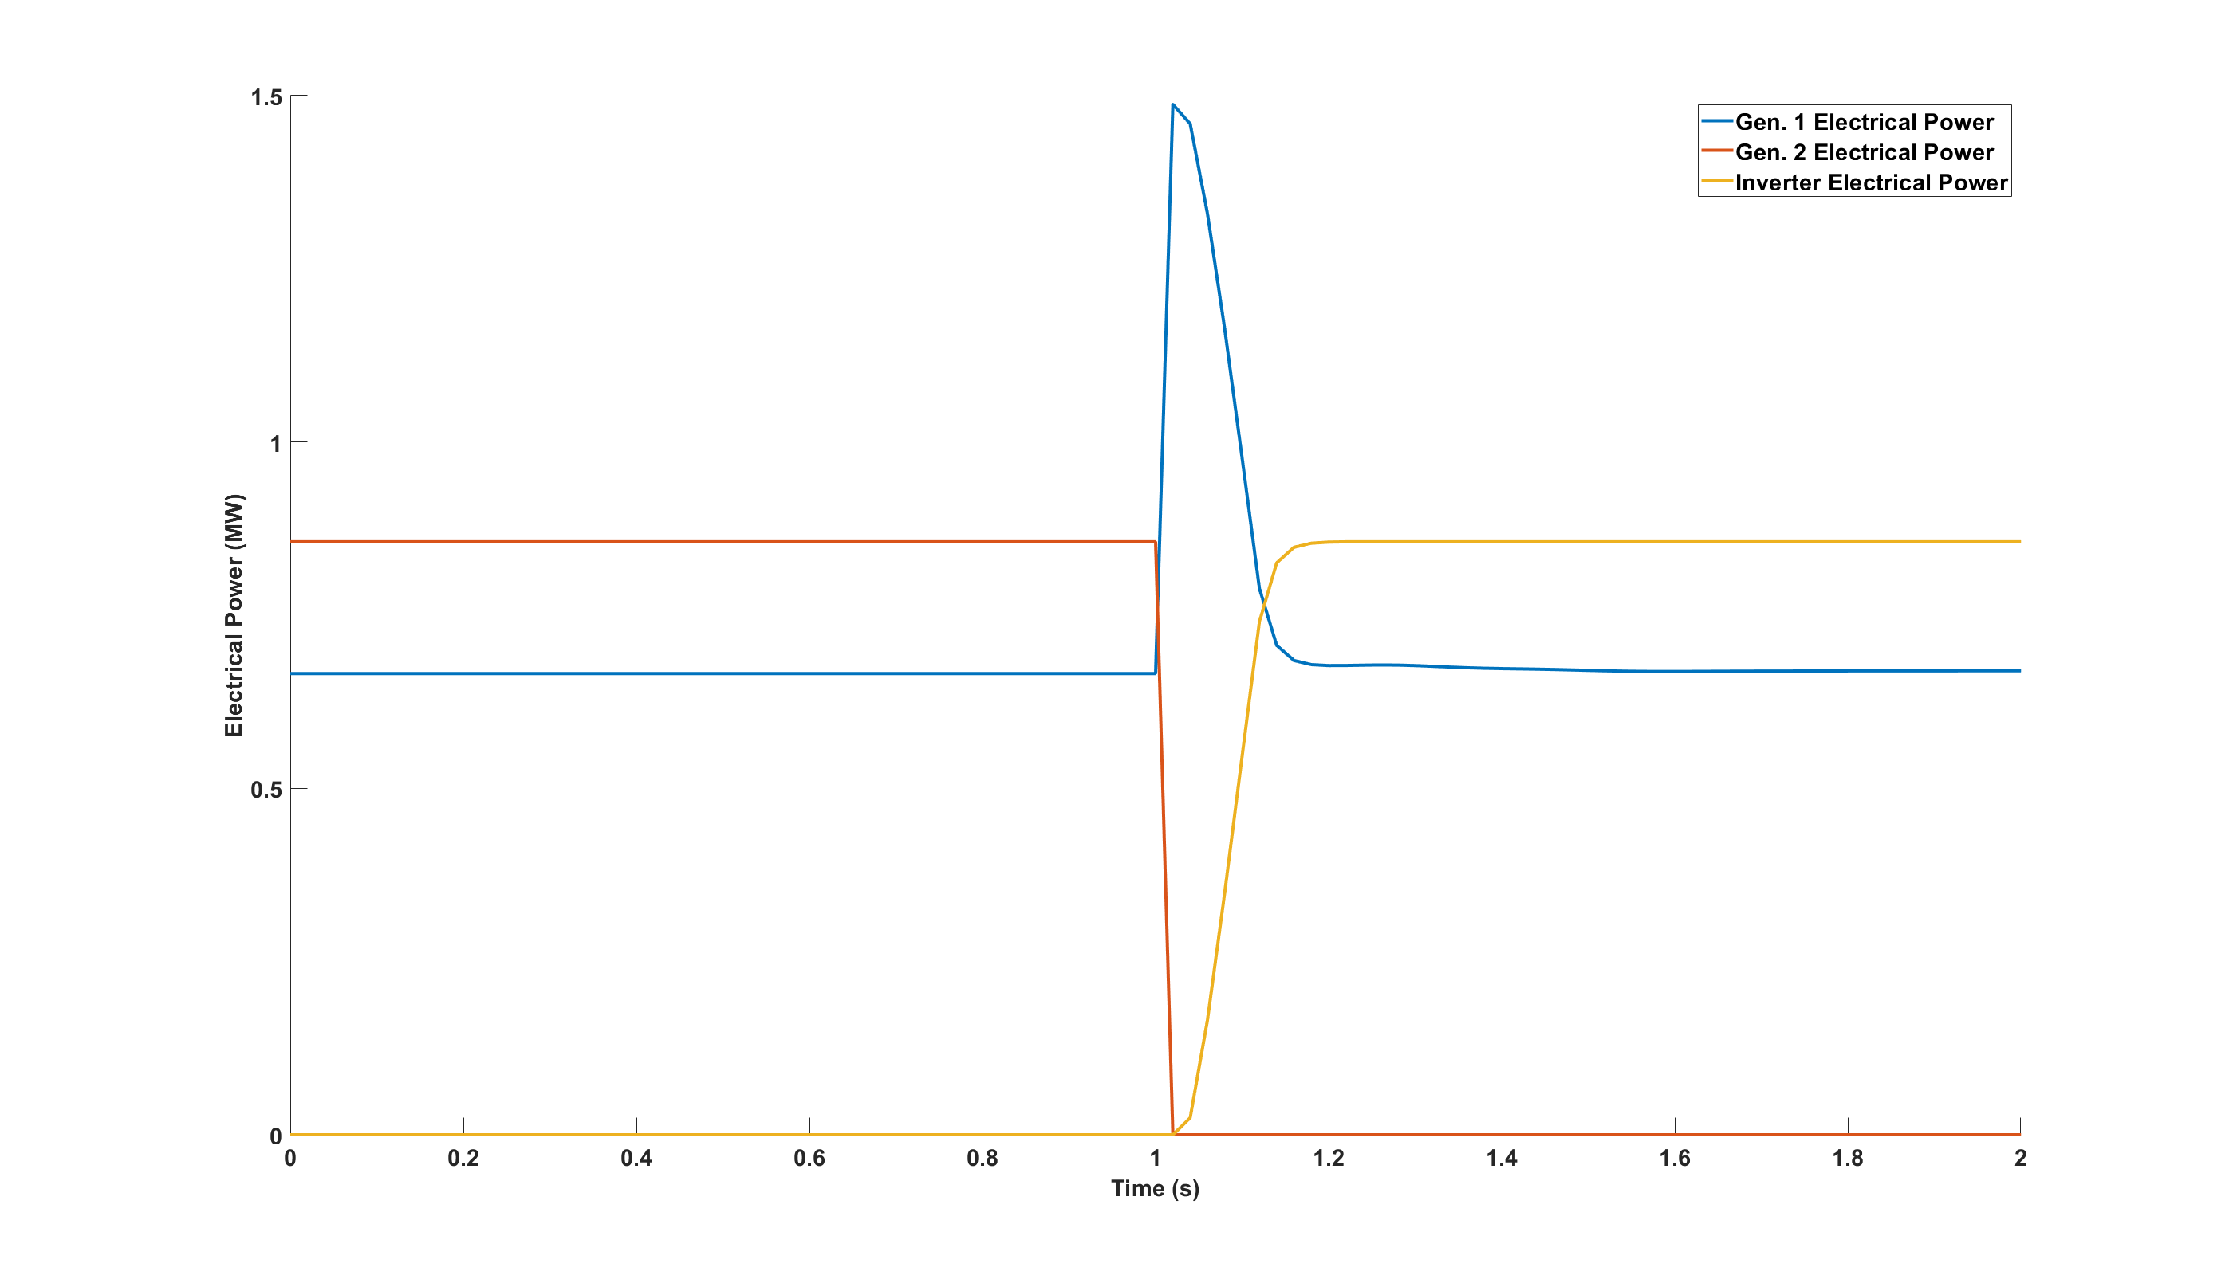
Automated Engineering
Time domain analysis

Slide 17
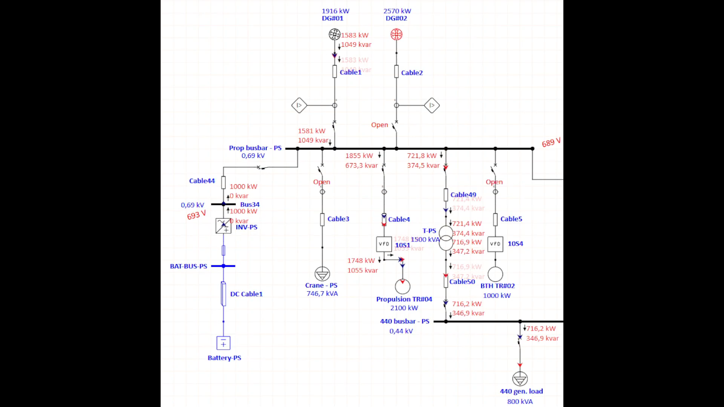
Automated Engineering
Load flow analysis

Slide 18
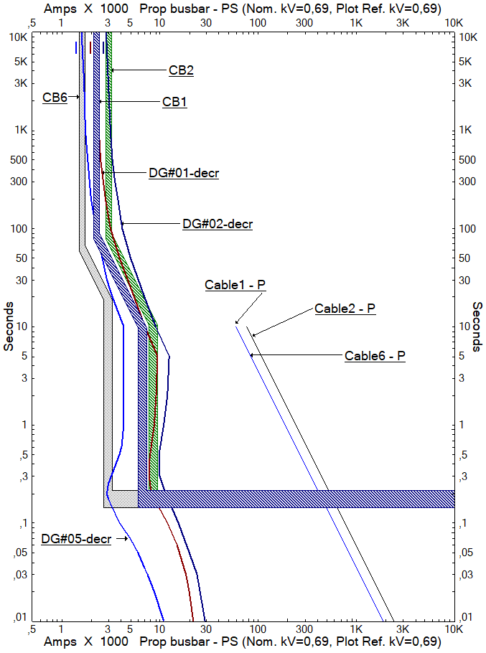
Automated
Engineering
Protection and Selectivity

Slide 19
Automated Engineering
Basic design in consultancy phase
Proof of Concept with optimized solution
Concurrent engineering
Shorter engineering lead time
Cost saving modeling

Slide 20
